Slide 1
What is LSTM?
LSTM (Long Short-Term Memory) is a recurrent neural network (RNN) architecture widely used in Deep Learning. It excels at capturing long-term dependencies, making it ideal for sequence prediction tasks.

Slide 2
Traditional ANN vs LSTM
Unlike traditional neural networks, LSTM incorporates feedback connections, allowing it to process entire sequences of data, not just individual data points. This makes it highly effective in understanding and predicting patterns in sequential data like time series, text, and speech.
LSTM has become a powerful tool in artificial intelligence and deep learning, enabling breakthroughs in various fields by uncovering valuable insights from sequential data.

Slide 4
One look at LSTM
https://youtu.be/Z03f7Wu5a6A

Slide 5
LSTM Architecture
In the introduction to long short-term memory, we learned that it resolves the vanishing gradient problem faced by RNN, so now, in this section, we will see how it resolves this problem by learning the architecture of the LSTM.
At a high level, LSTM works very much like an RNN cell.
Here is the internal functioning of the LSTM network.
The LSTM network architecture consists of three parts, as shown in the image below, and each part performs an individual function.

Slide 6
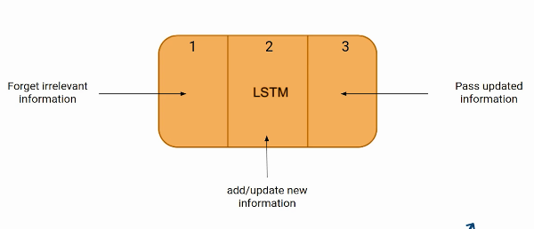

Slide 7
The Logic Behind LSTM
The first part chooses whether the information coming from the previous timestamp is to be remembered or is irrelevant and can be forgotten.
In the second part, the cell tries to learn new information from the input to this cell.
At last, in the third part, the cell passes the updated information from the current timestamp to the next timestamp.
This one cycle of LSTM is considered a single-time step.
These three parts of an LSTM unit are known as gates.
They control the flow of information in and out of the memory cell or lstm cell. The first gate is called Forget gate, the second gate is known as the Input gate, and the last one is the Output gate.
An LSTM unit that consists of these three gates and a memory cell or lstm cell can be considered as a layer of neurons in traditional feedforward neural network, with each neuron having a hidden layer and a current state.

Slide 8
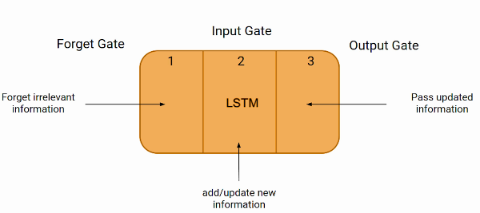

Slide 9
Just like a simple RNN, an LSTM also has a hidden state where H(t-1) represents the hidden state of the previous timestamp and Ht is the hidden state of the current timestamp.
In addition to that, LSTM also has a cell state represented by C(t-1) and C(t) for the previous and current timestamps, respectively .
Here the hidden state is known as Short term memory, and the cell state is known as Long term memory. Refer to the following image

Slide 10
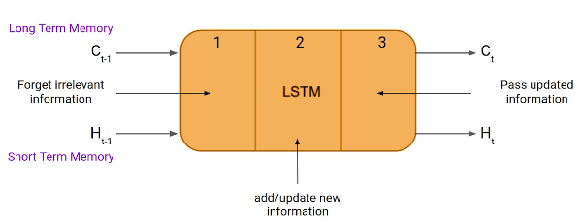

Slide 11
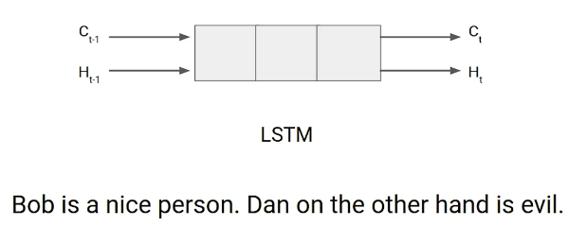
It is interesting to note that the cell state carries the information along with all the timestamps.

Slide 12
Example of LTSM Working
Let’s take an example to understand how LSTM works.
Here we have two sentences separated by a full stop.
The first sentence is “Bob is a nice person,” and the second sentence is “Dan, on the Other hand, is evil”.
It is very clear, in the first sentence, we are talking about Bob, and as soon as we encounter the full stop(.), we started talking about Dan.

Slide 13
Work of Forget Gate
As we move from the first sentence to the second sentence, our network should realize that we are no more talking about Bob. Now our subject is Dan. Here, the Forget gate of the network allows it to forget about it.
Let’s understand the roles played by these gates in LSTM architecture.

Slide 14
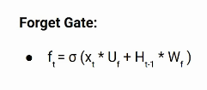
Forget Gate
In a cell of the LSTM neural network, the first step is to decide whether we should keep the information from the previous time step or forget it. Here is the equation for forget gate.
Let’s try to understand the equation, here
Xt: input to the current timestamp.
Uf: weight associated with the input
Ht-1: The hidden state of the previous timestamp
Wf: It is the weight matrix associated with the hidden state

Slide 15
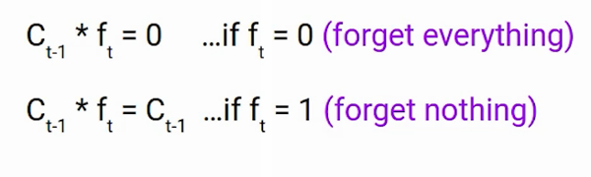
Forget Everything / Nothing
Later, a sigmoid function is applied to it. That will make ft a number between 0 and 1.
This ft is later multiplied with the cell state of the previous timestamp, as shown below.

Slide 16
Input Gate
Let’s take another example.
“Bob knows swimming. He told me over the phone that he had served the navy for four long years.”
So, in both these sentences, we are talking about Bob. However, both give different kinds of information about Bob.
In the first sentence, we get the information that he knows swimming. Whereas the second sentence tells, he uses the phone and served in the navy for four years.

Slide 17
Now just think about it, based on the context given in the first sentence, which information in the second sentence is critical?
First, he used the phone to tell, or he served in the navy.
In this context, it doesn’t matter whether he used the phone or any other medium of communication to pass on the information.
The fact that he was in the navy is important information, and this is something we want our model to remember for future computation. This is the task of the Input gate.

Slide 18
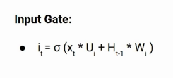
The input gate is used to quantify the importance of the new information carried by the input. Here is the equation of the input gate
Here,
Xt: Input at the current timestamp t
Ui: weight matrix of input
Ht-1: A hidden state at the previous timestamp
Wi: Weight matrix of input associated with hidden state

Slide 19
New Information
Again we have applied the sigmoid function over it. As a result, the value of I at timestamp t will be between 0 and 1
Now the new information that needed to be passed to the cell state is a function of a hidden state at the previous timestamp t-1 and input x at timestamp t. The activation function here is tanh.
Due to the tanh function, the value of new information will be between -1 and 1. If the value of Nt is negative, the information is subtracted from the cell state, and if the value is positive, the information is added to the cell state at the current timestamp.

Slide 20

However, the Nt won’t be added directly to the cell state. Here comes the updated equation:
Here, Ct-1 is the cell state at the current timestamp, and the others are the values we have calculated previously.

Slide 21
Output Gate
Now consider this sentence.
“Bob single-handedly fought the enemy and died for his country. For his contributions, brave______.”
During this task, we have to complete the second sentence. Now, the minute we see the word brave, we know that we are talking about a person. In the sentence, only Bob is brave, we can not say the enemy is brave, or the country is brave. So based on the current expectation, we have to give a relevant word to fill in the blank. That word is our output, and this is the function of our Output gate.

Slide 22

